Slide 1
Real-Time Neural Spike Detection
Neuralink, US 2021/0012909 A1, Filed 9/9/2020, Published 1/21/2021
5/30/2024

Slide 2
Background
Key information of neural activity can be identified based on neuron spikes - action potential in neuron
Spikes - characteristic rises in voltage across plasma membrane in cell, caused by depolarization + repolarization in membrane
Extant methods:
Total voltage exceeding some threshold - lots of false positives
Machine learning - very expensive, great deal of power

Slide 3
How to Detect Neuron Spikes in Real Time
Purpose: To detect and classify characteristic signals such as brain neuron spikes
Table of contents:
What is a spike?
Integrated Chip Design
Compression Engine
Basics: Floating vs Fixed-Point Computation
Overall Procedure:
Receive Biological Signal
Filter Signal
Smooth Signal
Identify Fit Values
Compute Charateristic Values
Determine Threshold Values
Determine whether spike(s) are detected
Transmit Indication of Spike
Additional: Classify Spikes
Advantages of This System

Slide 4
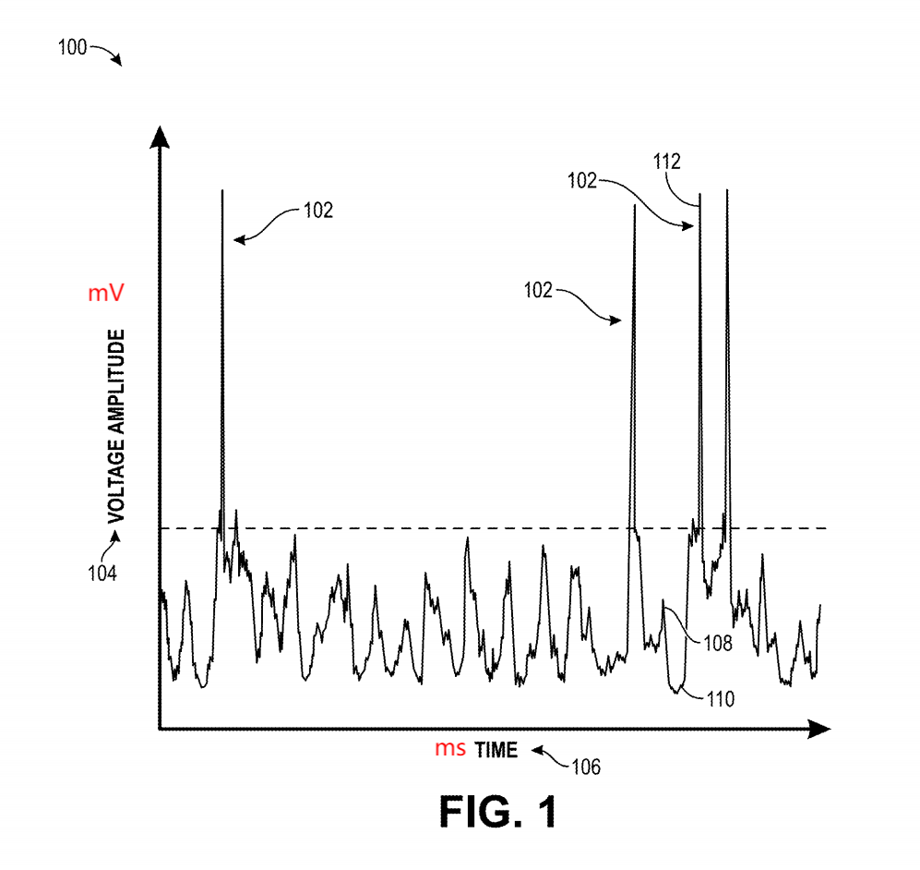
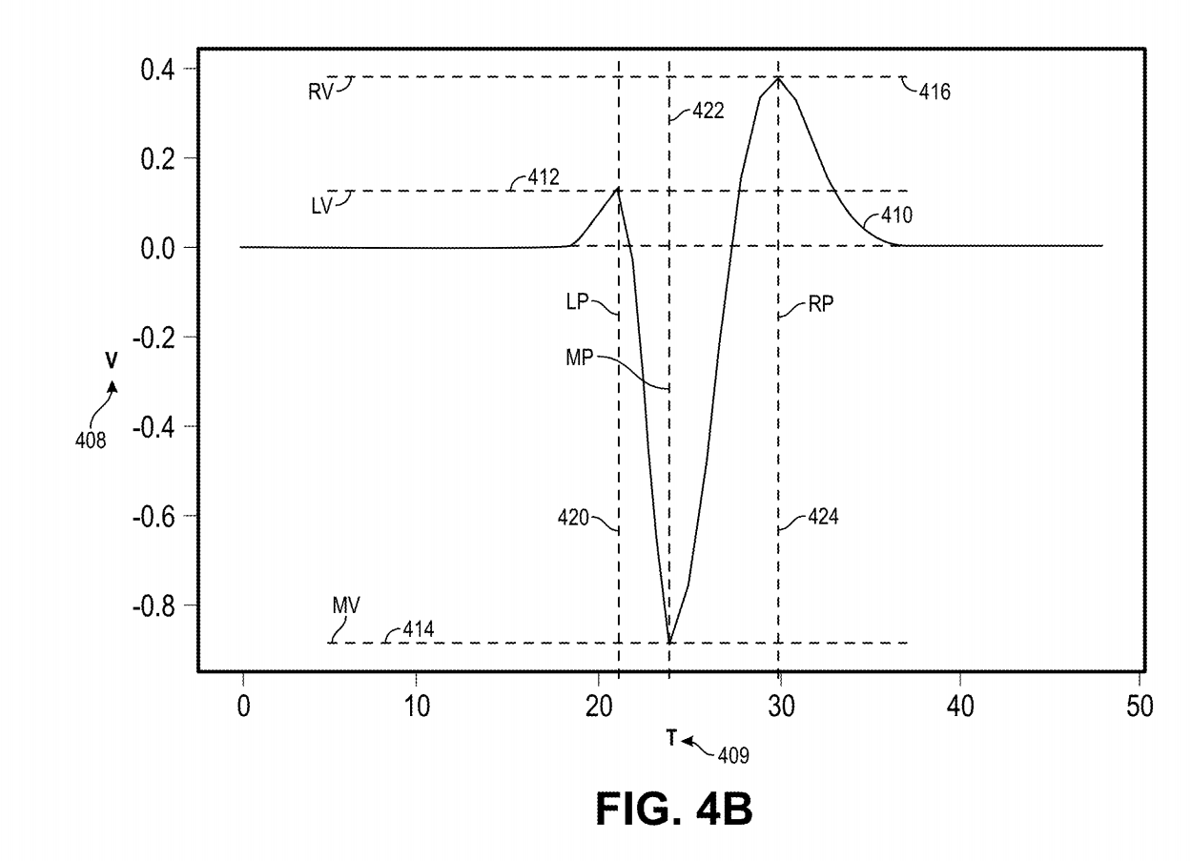
What is a spike?
Spike - characteristic rises & falls
Start out with initial resting value
First positive change in amplitude
Reduction in amplitude below initial resting value
Second positive change in amplitude greater than first positive change
mV
ms

Slide 5
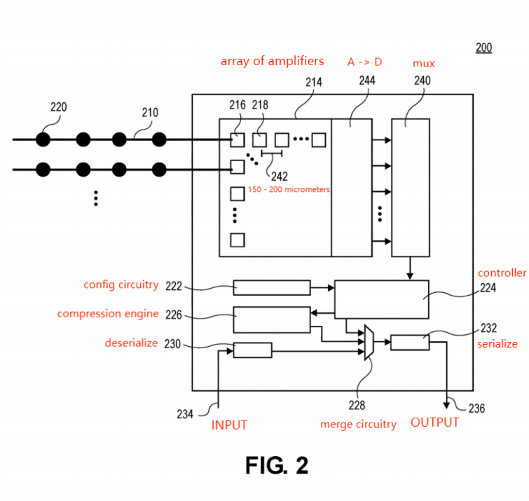
Integrated Chip Design

Slide 6
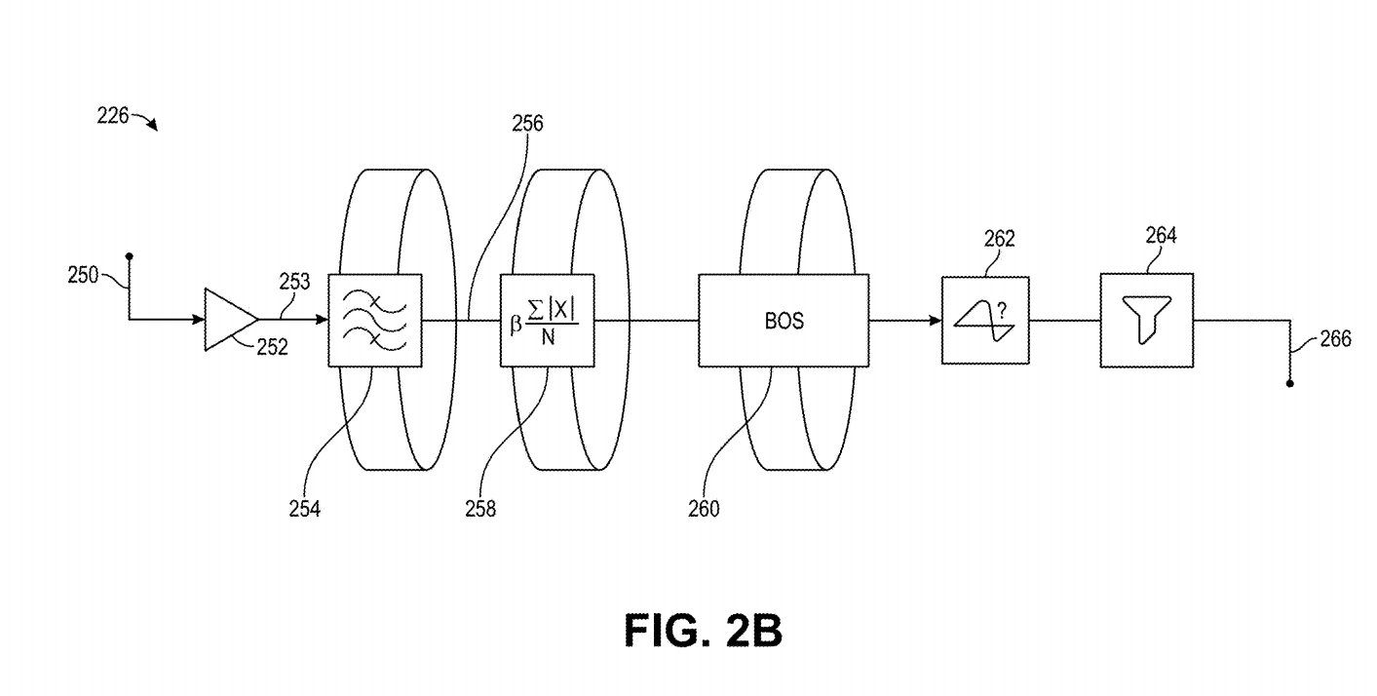
Compression Engine
Spike probability evaluation
INPUT
Spike classifier
OUTPUT
Buffered online spike (BOS) detector
Bandpass filter
MAD + threshold calculation

Slide 7
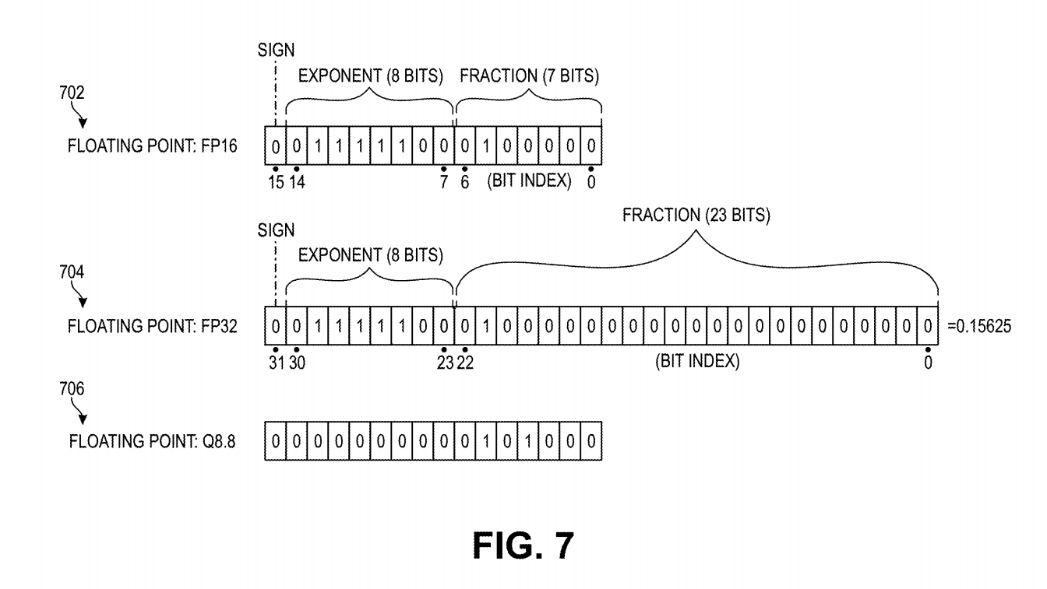
Basics: Floating Point Representations
ANY number of decimals
Conventional - Very inefficient & resource intensive computationally
Used in software implementations (Python)

Slide 8
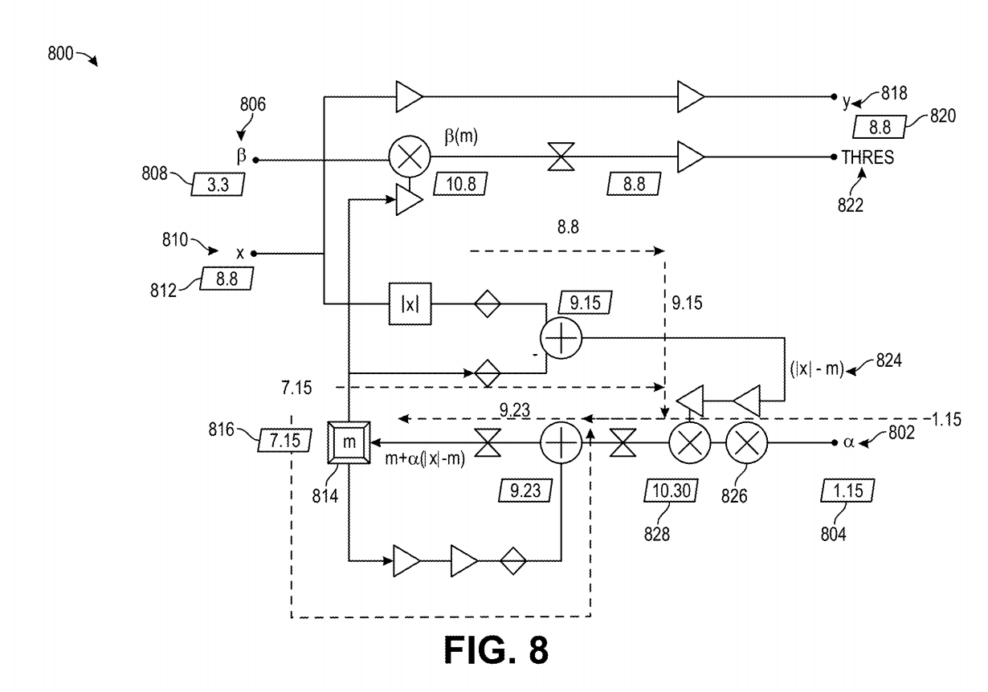
Basics: Fixed Point Representation
FIXED number of decimals
More computationally efficient
ex. Q7.14: allocate 7 bits for number (exponent), 14 bits for fraction
Used in hardware implementations (rarely in software)

Slide 9
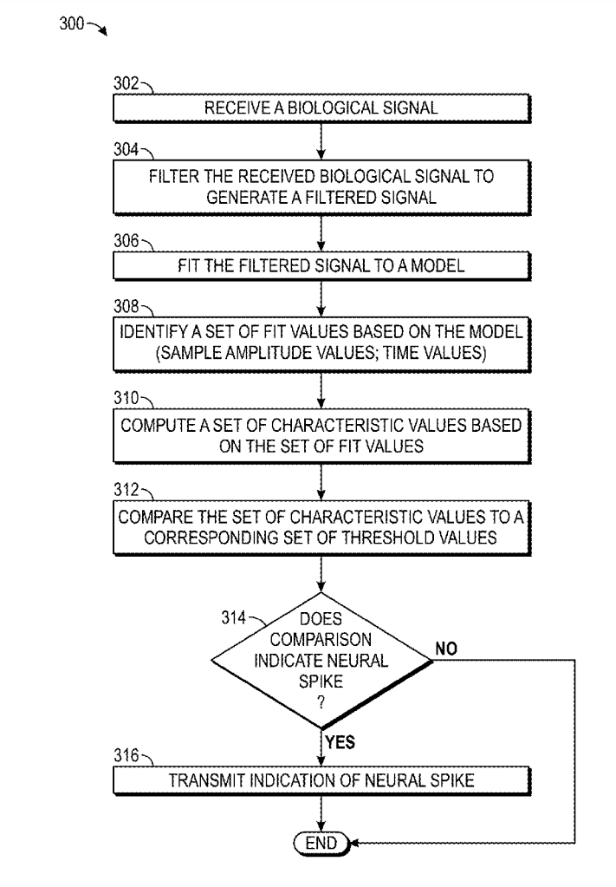
Overall Procedure

Slide 10
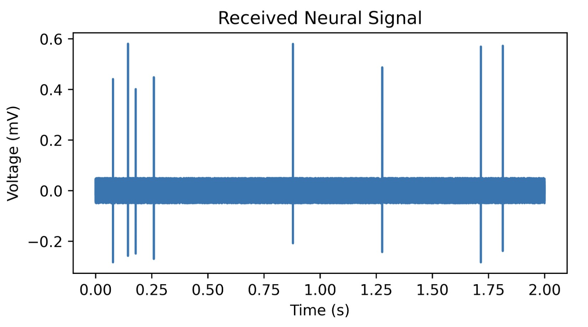
1. Receive Biological Signal
Receive neurological voltage signal from electrode leads to IC chip

Slide 11
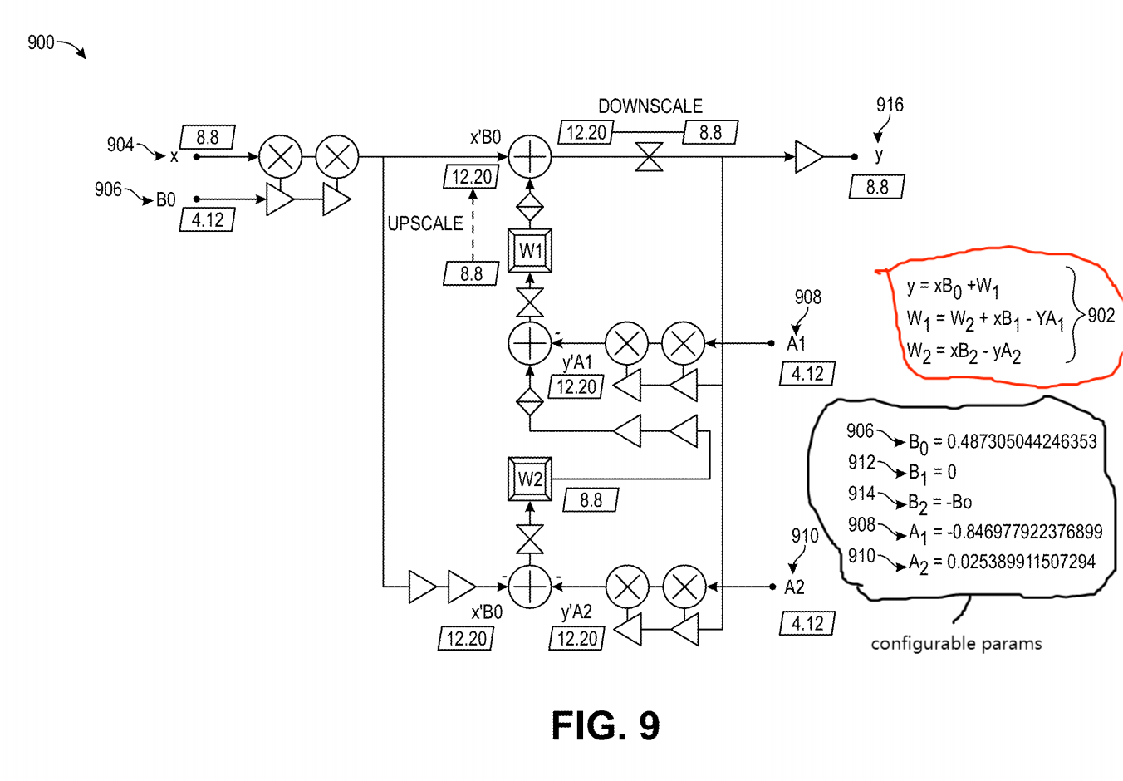
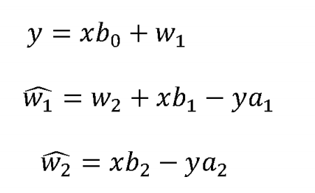
2. Filter Signal
Filtering - Get rid of noisy signals, retain a subset of signals
This patent uses a 16-bit digital Infinite Impulse Response (IIR) Butterworth 2nd-order Bandpass Filter (Fig. 9)
Equations:
x - original sample, y - filtered signal
a1, a2, b0, b1, b2 - user-configurable params
w1_hat, w2_hat - intermediate states
This algorithm ALWAYS runs while the device is on!
multiplication (x), addition (+), conversion (hourglass)
division - assymetric multipliers (used with cycles) decided by smallest operand (16b)

Slide 12
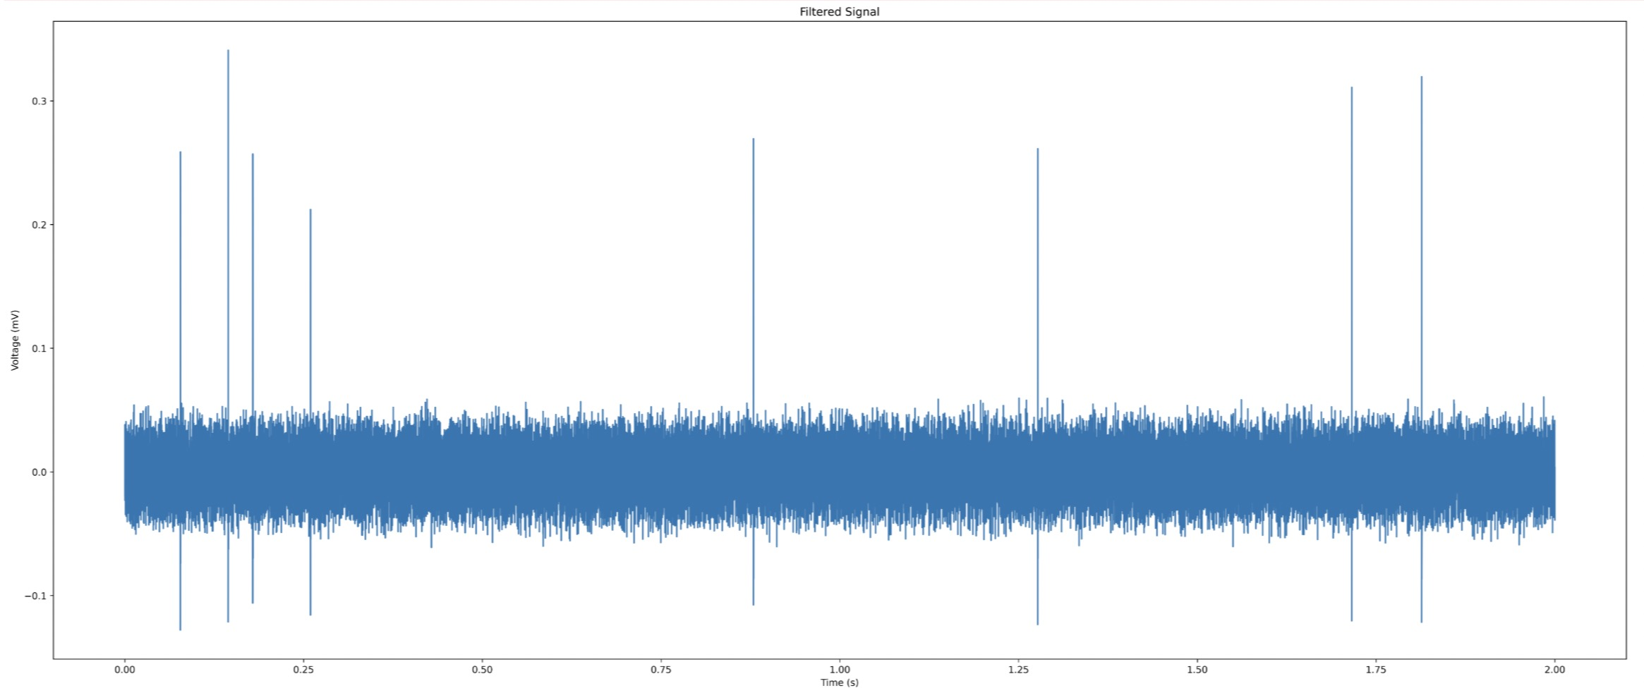

Slide 13
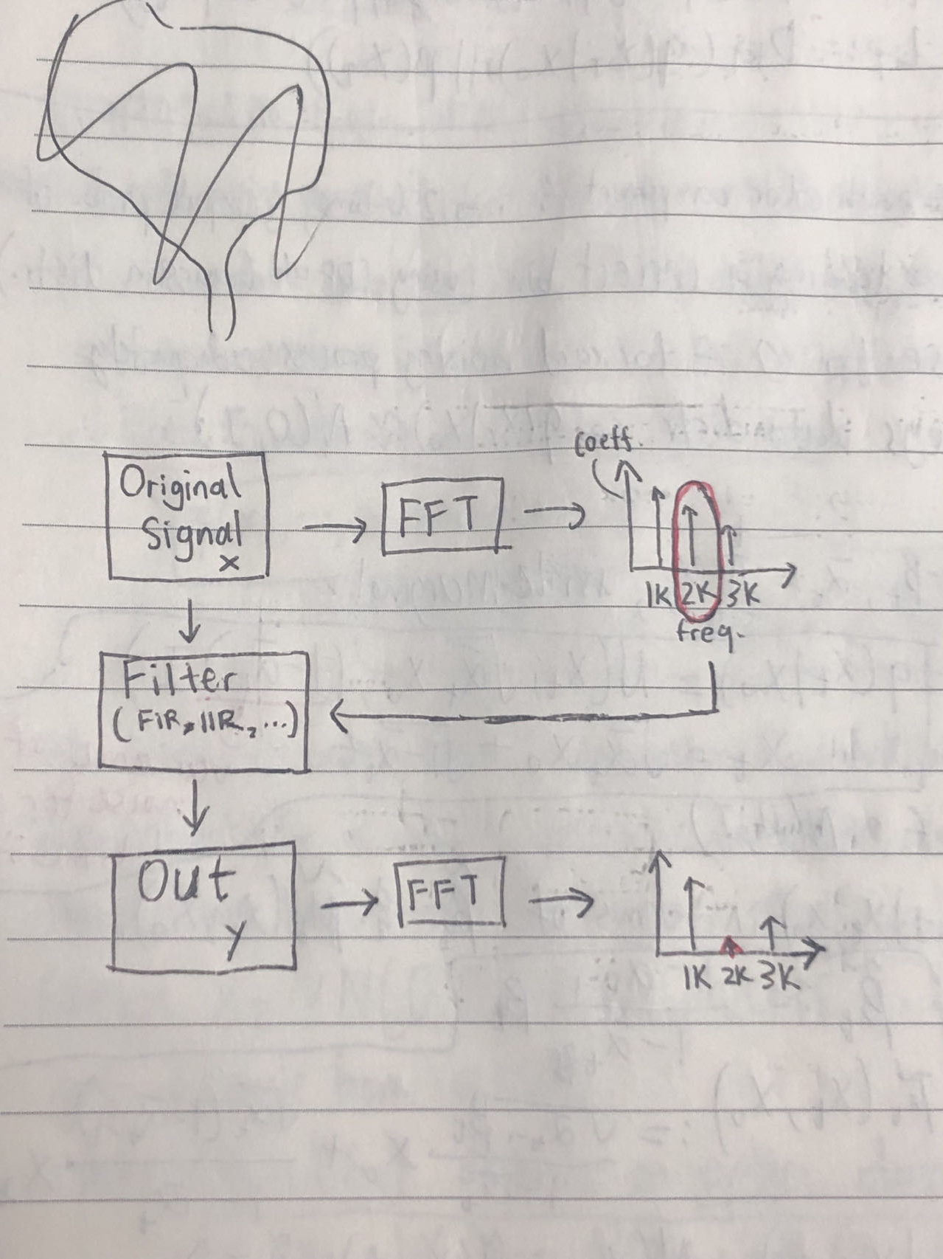
For Deeper Intuition of Filtering Signals
1. Original Signal
2. Fast-Fourier Transform (FFT) of original signal
Determine frequency band [low_cut, high_cut] based on FFT (which principal components do we keep/remove?)
3. Filtered signal
4. Fast-Fourier Transform (FFT) of filtered signal
Check if filtered signal & FFT plots are what is desired

Slide 14
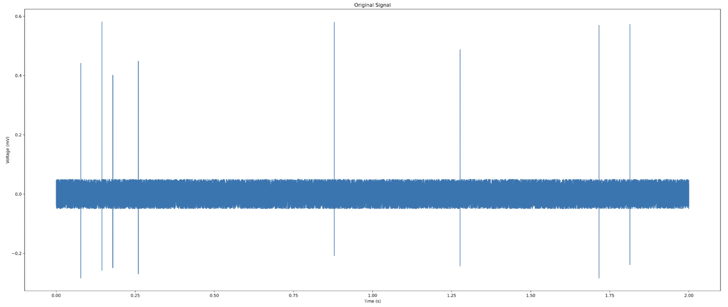
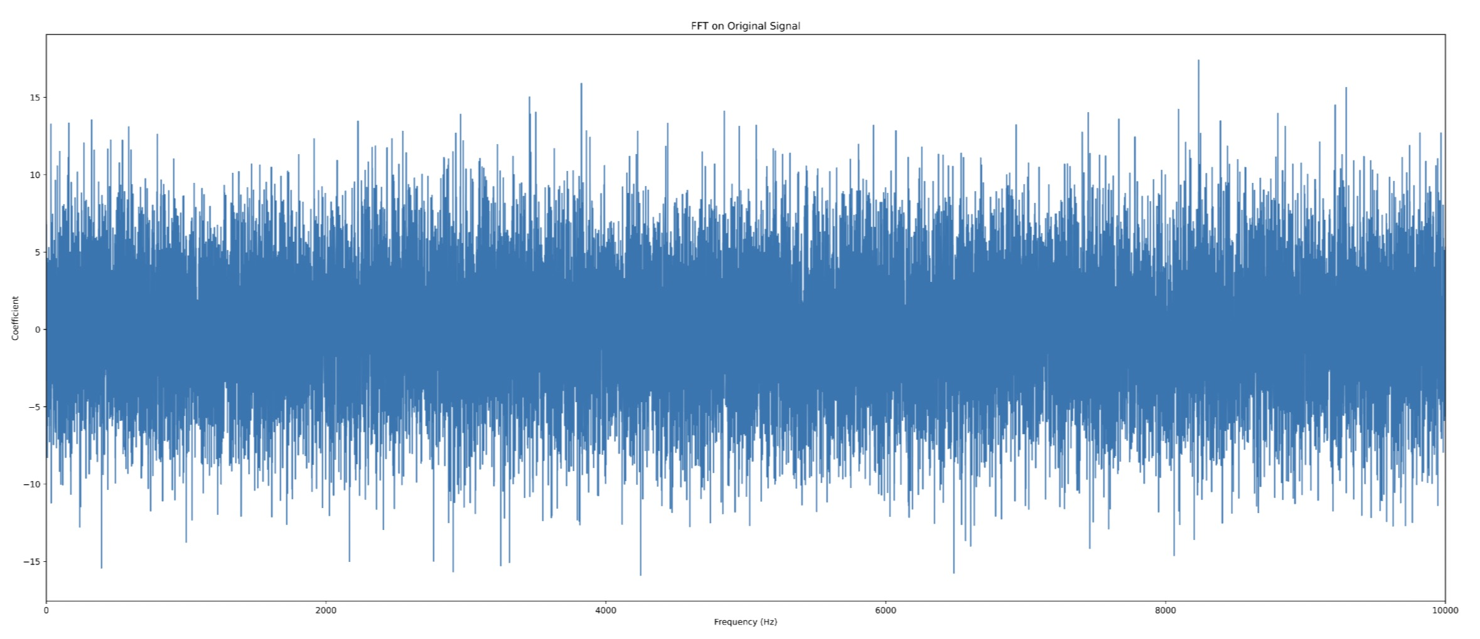
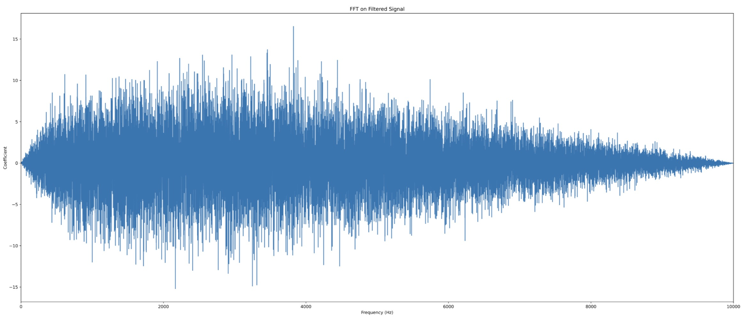
1. Original
3. Filtered
2. FFT on original
4. FFT on filtered

Slide 15
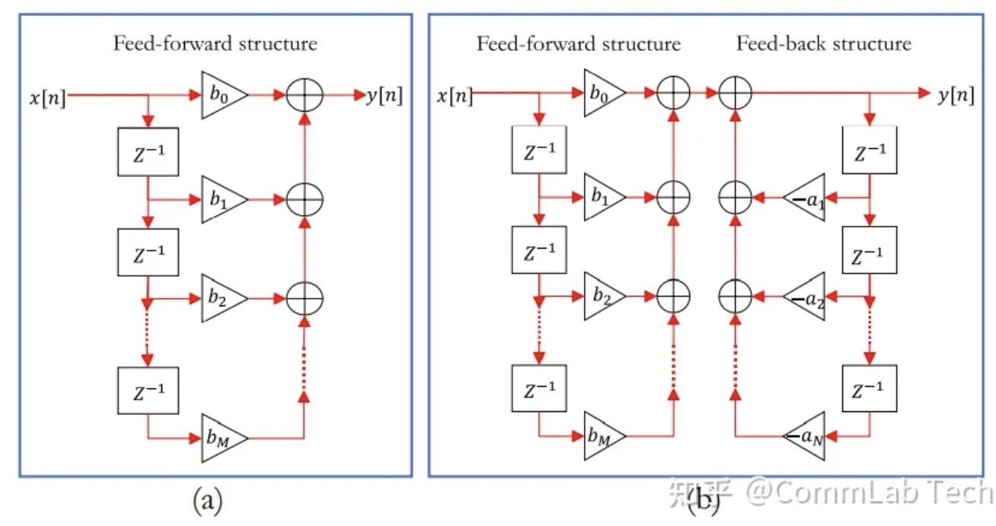
Filtering Basics: Finite Impulse Response (FIR) vs Infinite Impulse Response (IIR)
Finite Impulse Response (FIR)
Infinite Impulse Response (IIR)
Feed-forward only (no loops)
Used in engineering
Easy to implement in hardware due to high precision
Includes feed-back structure (loops)
Used in theoretical research
Very difficult to implement in hardware (usually used in software such as Python)

Slide 16
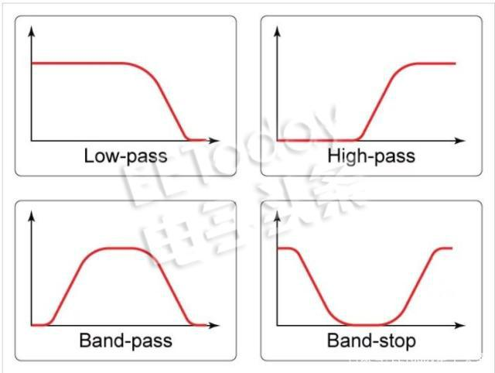
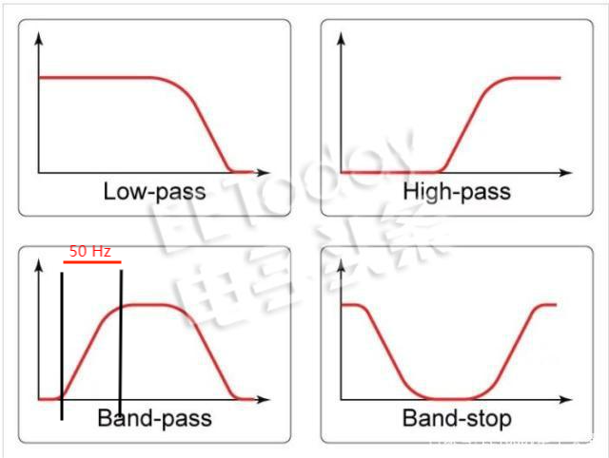
Filtering Basics: Low-Pass, High-Pass, Band-Pass, Band-Stop
Low-pass: Keep low frequency signal portions
High-pass: Keep high frequency signal portions
Band-pass: Keep signal portions in a configured frequency band
Band-stop: Remove signal portions that are in configured frequency band
Note: Make sure that configured bands are wide enough!

Slide 17
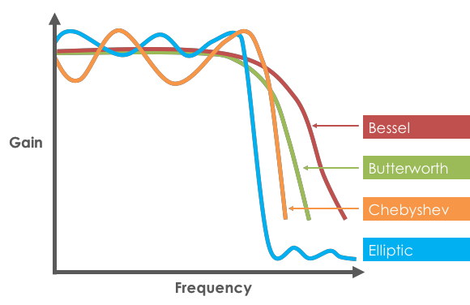
Filtering Basics: Bessel, Butterworth, Chebyshev, Elliptic
Butterworth – maximally flat frequency response in passband
Chebyshev – steeper roll-off with ripple in passband/stopband
Bessel – maximally flat group delay
Elliptic – steeper roll-up with ripple in passband and stopband, but steepest roll-off achievable in given order
Patent uses Butterworth filter:
Smooth frequency response in passband (for integrity of neural signals)
Roll-off not critical
Minimal phase shift
Computationally efficient
Commonly used in audio applications, neural signal processing

Slide 18
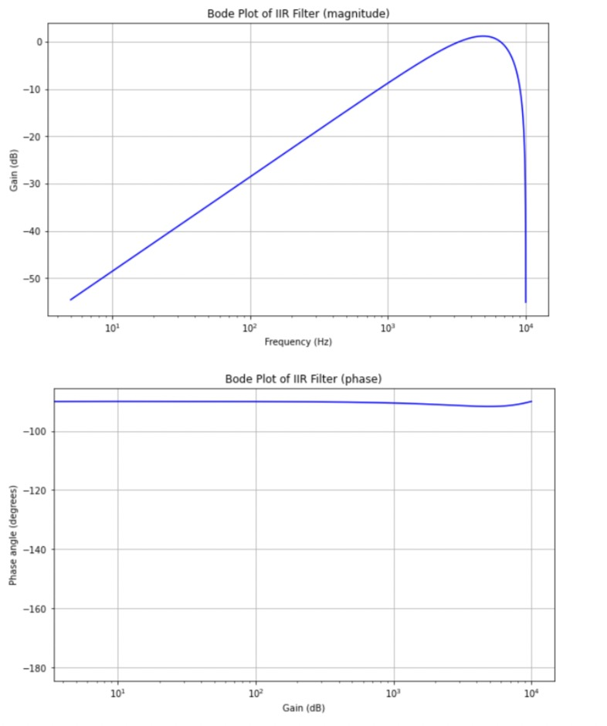
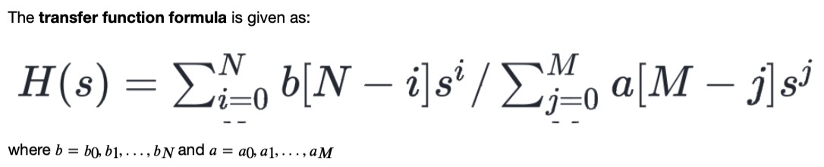
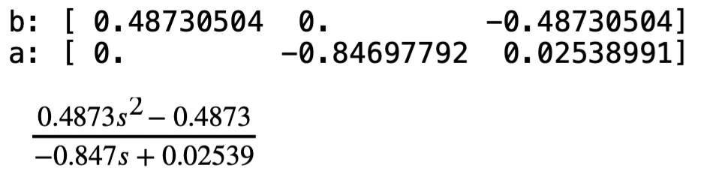
Filtering Basics: Bode Plot
Used for amplitude and frequency analysis
Obtained from transfer function params b (b0, b1, b2) and a (a1, a2)
2 separate plots: magnitude and phase
Used in engineering
Nyquist plot- used in research/academia (magnitude + phase plots all in one)

Slide 19
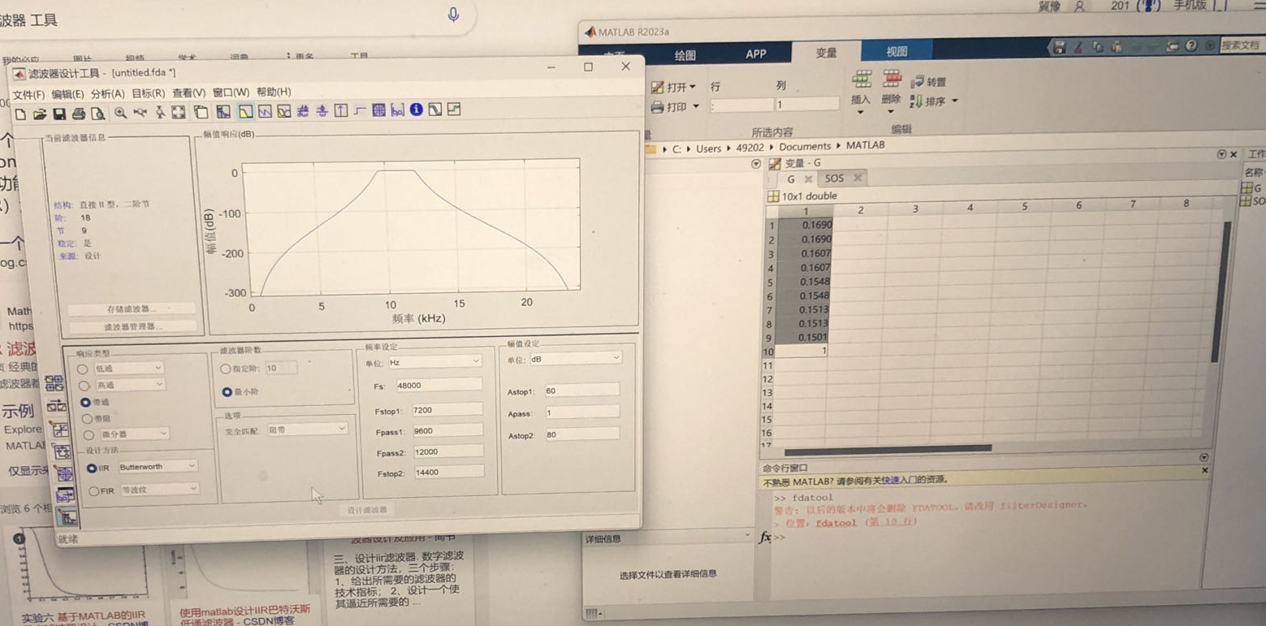
Filtering: Where do the params come from?
generated hyperparams from Bode graph/transfer function!
Normally, you would want to obtain the params b, a from the IIR filter itself to plot the Bode graph, instead of copying parameters.

Slide 20
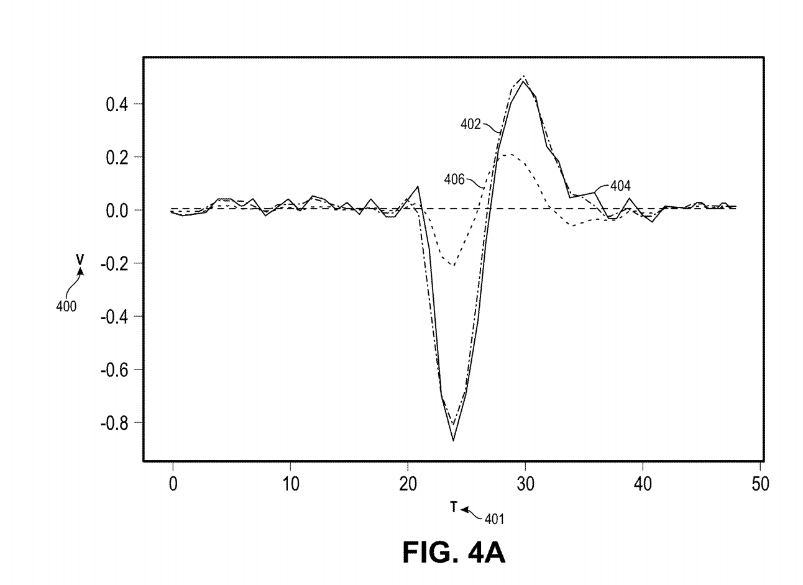
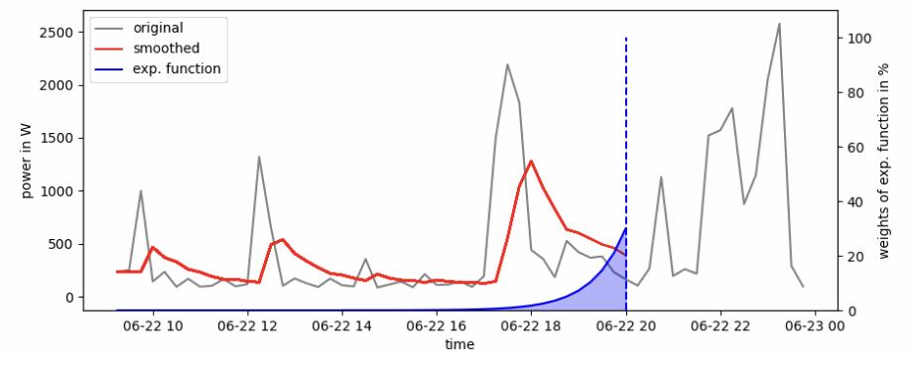
3. Smooth Signal
smoothed
trend
original
Smoothing - remove system noise for unbiased estimation and better quality data
Uses modern control theory
Exponential Smoothing - captures non-linearity (e.g., spikes) in data

Slide 21
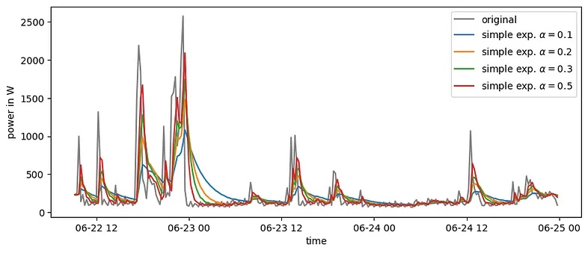
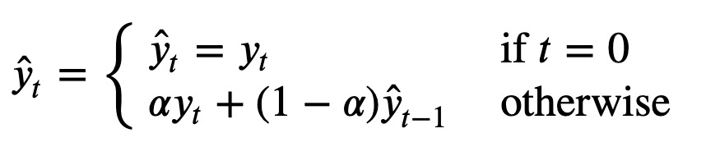
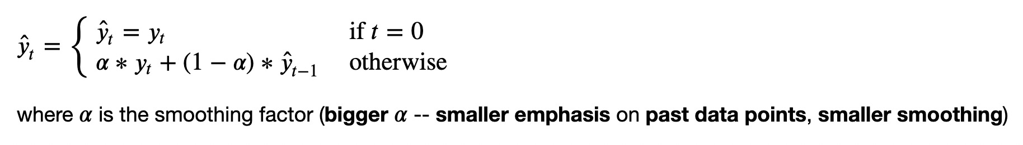
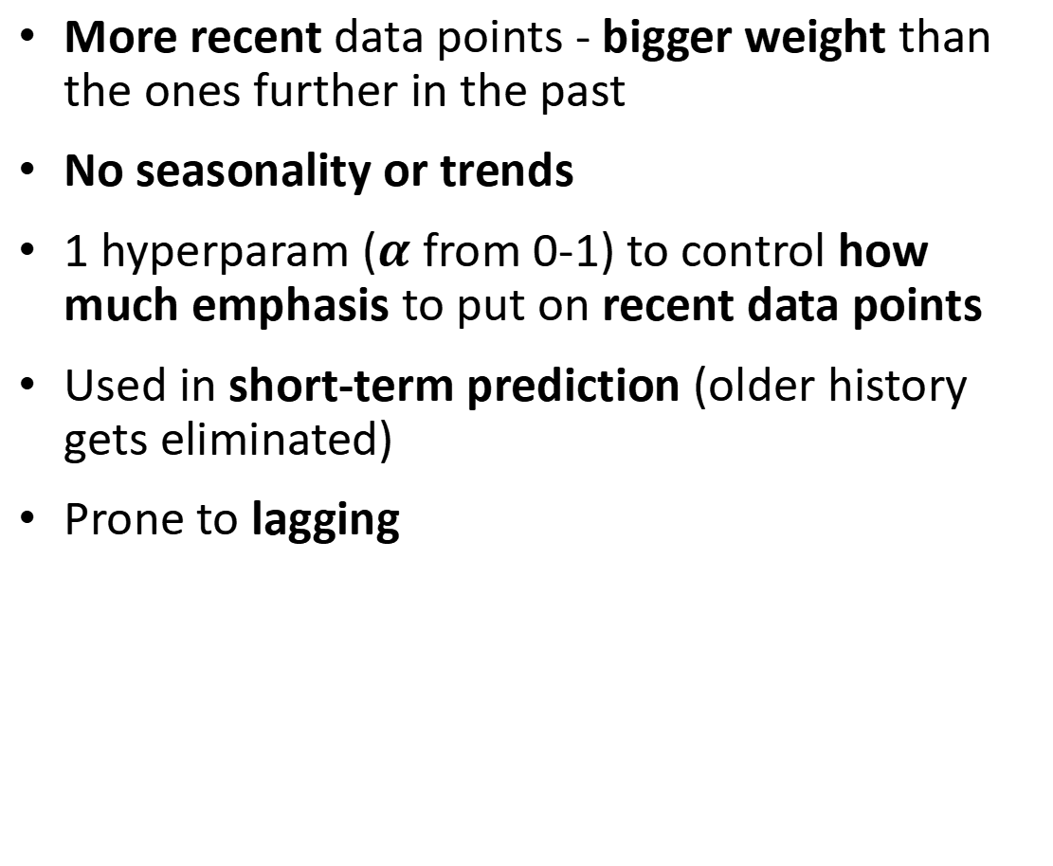
Single Exponential Smoothing
More recent data points - bigger weight than the ones further in the past
No seasonality or trends
1 hyperparam ($α$ from 0-1) to control how much emphasis to put on recent data points
Used in short-term prediction (older history gets eliminated)
Prone to lagging

Slide 22
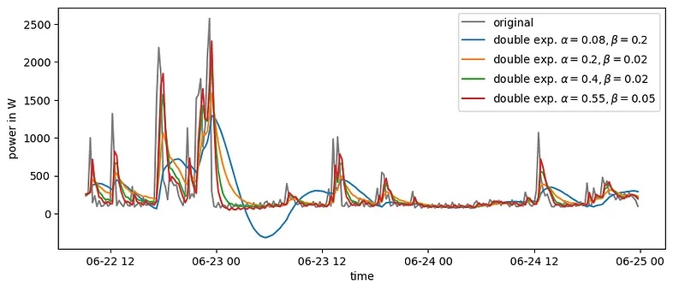
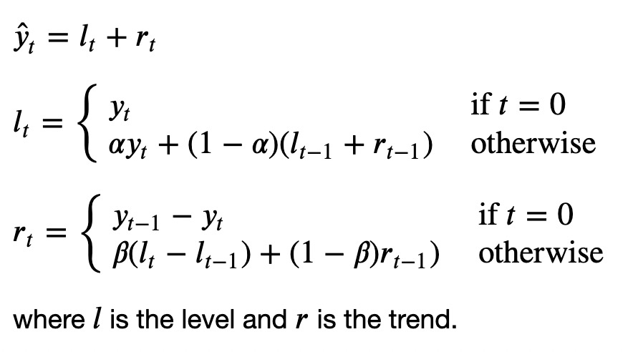
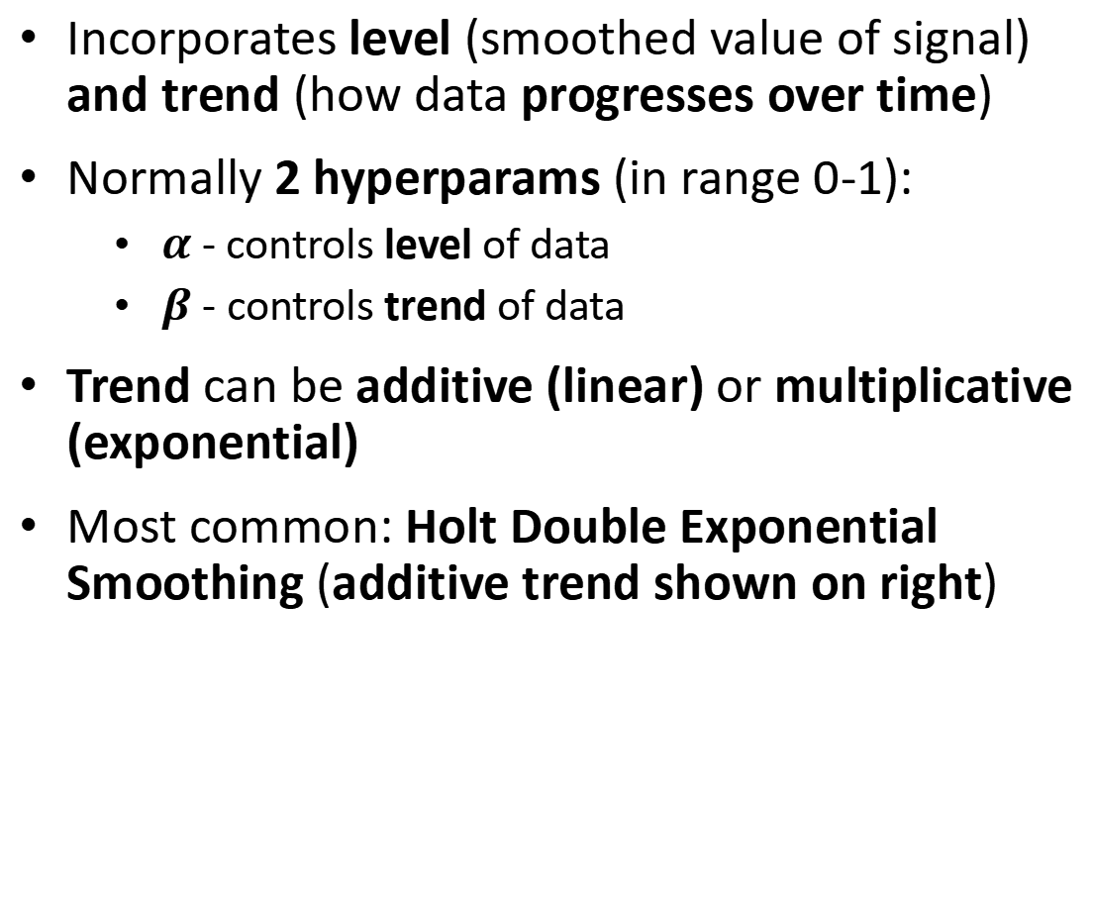
Double (Linear) Exponential Smoothing
Incorporates level (smoothed value of signal) and trend (how data progresses over time)
Normally 2 hyperparams (in range 0-1):
$α$ - controls level of data
$β$ - controls trend of data
Trend can be additive (linear) or multiplicative (exponential)
Most common: Holt Double Exponential Smoothing (additive trend shown on right)

Slide 23
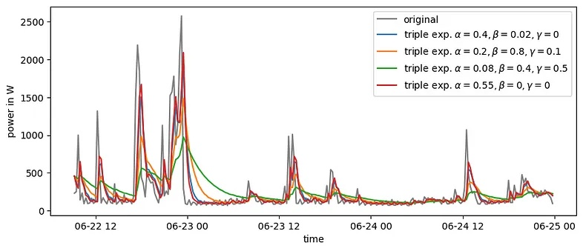
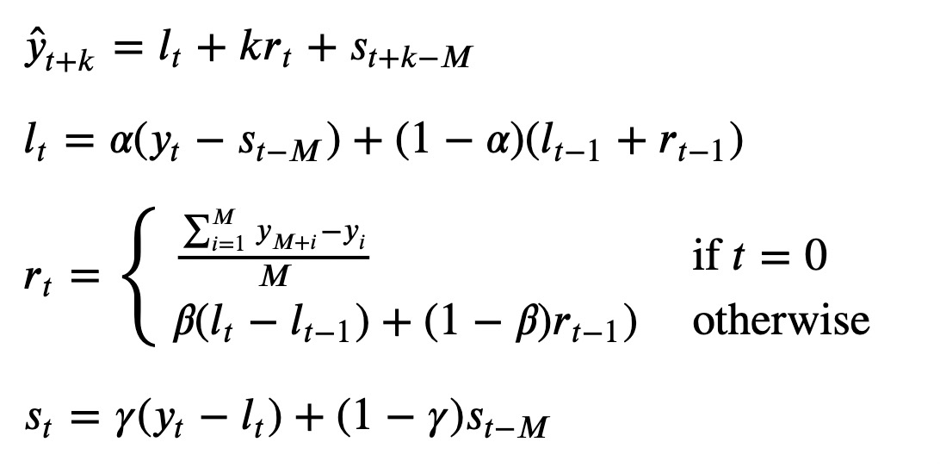
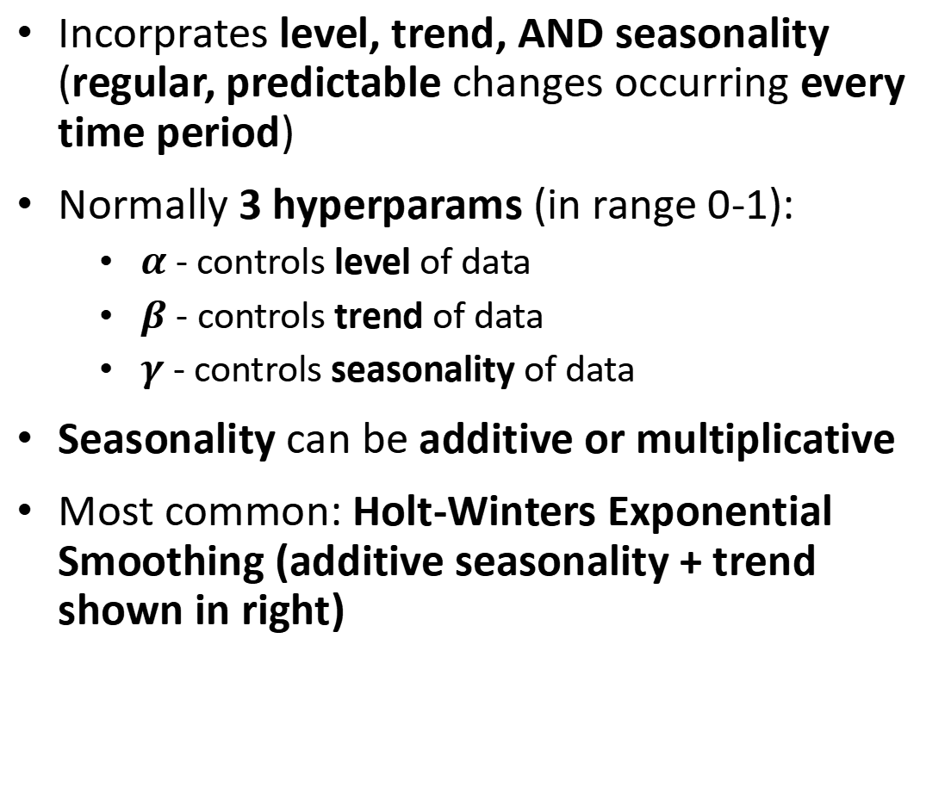
Triple Exponential Smoothing
Incorprates level, trend, AND seasonality (regular, predictable changes occurring every time period)
Normally 3 hyperparams (in range 0-1):
$α$ - controls level of data
$β$ - controls trend of data
$γ$ - controls seasonality of data
Seasonality can be additive or multiplicative
Most common: Holt-Winters Exponential Smoothing (additive seasonality + trend shown in right)

Slide 24
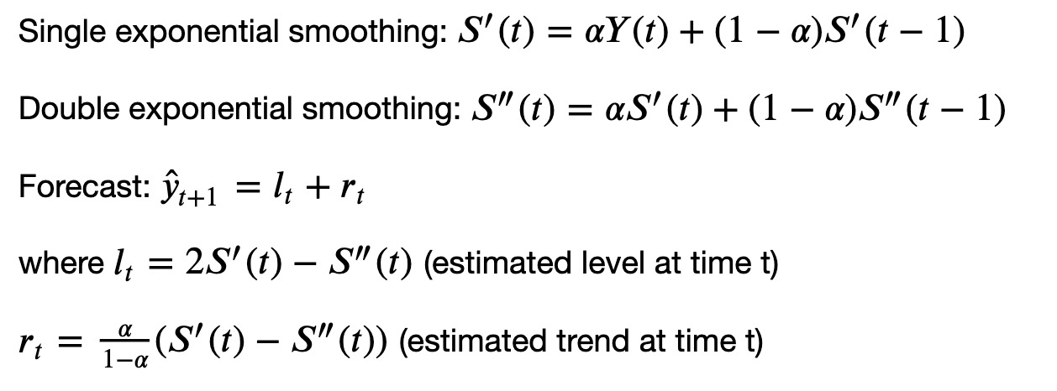
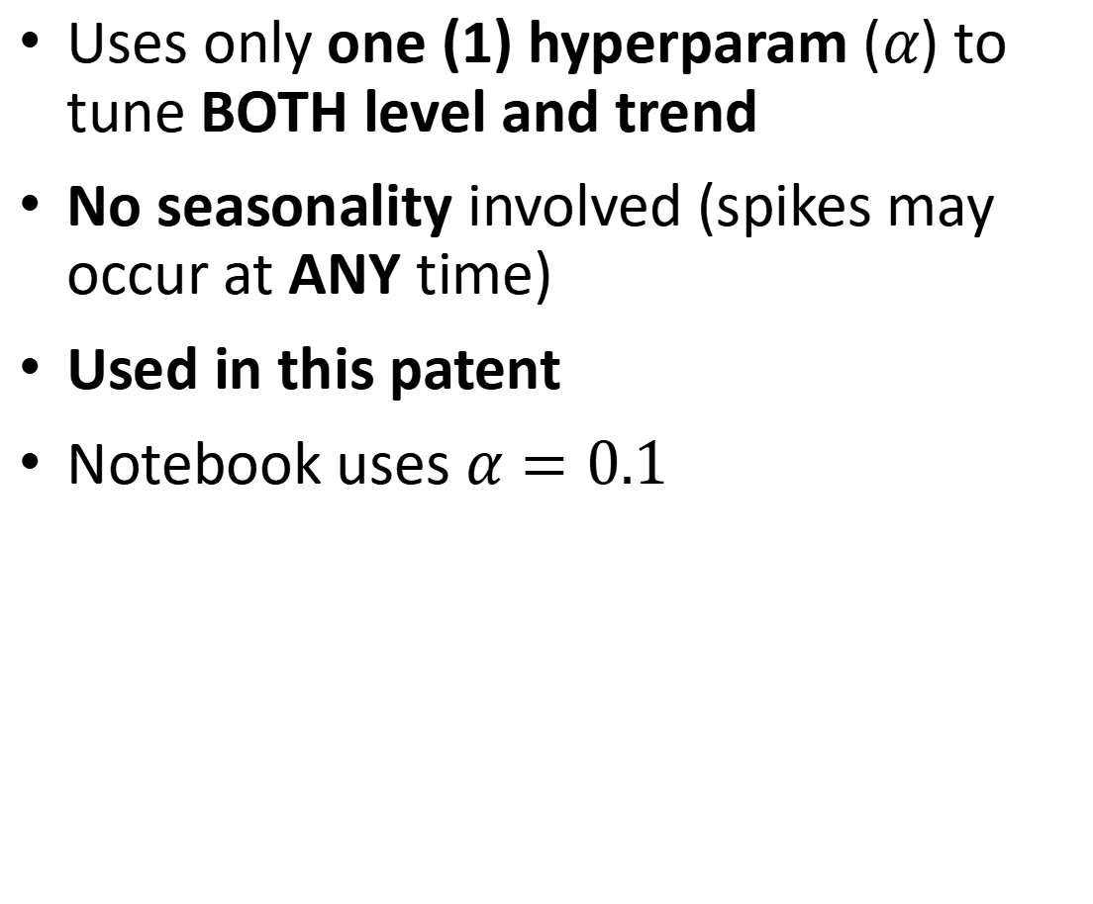
Brown’s Double Exponential Smoothing (used in patent)
Uses only one (1) hyperparam ($α$) to tune BOTH level and trend
No seasonality involved (spikes may occur at ANY time)
Used in this patent
Notebook uses $α=0.1$

Slide 25
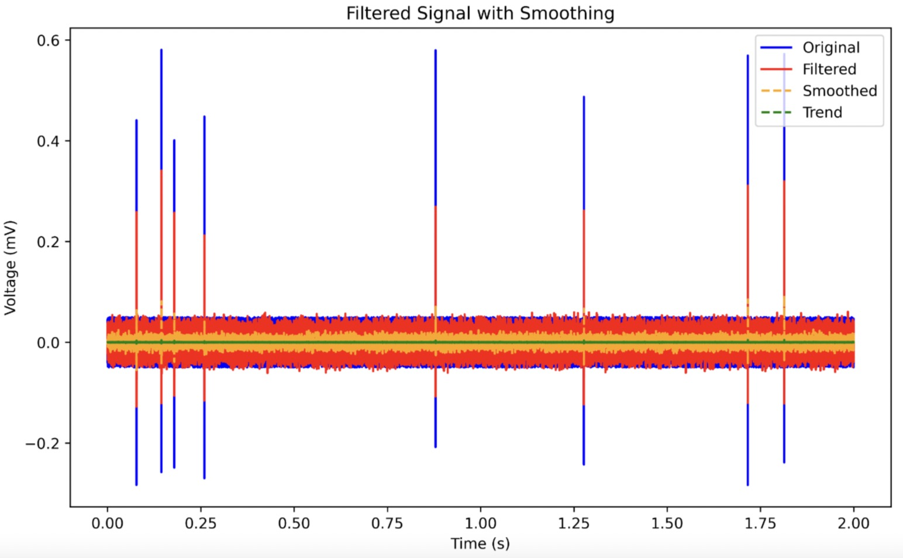

Slide 26
4. Identify fit values
ldist
i.e., identify local maxima and minima of filtered signal in each time window
Can (optionally, but not needed) plot a polynomial function to identify fit values
rdist

Slide 27
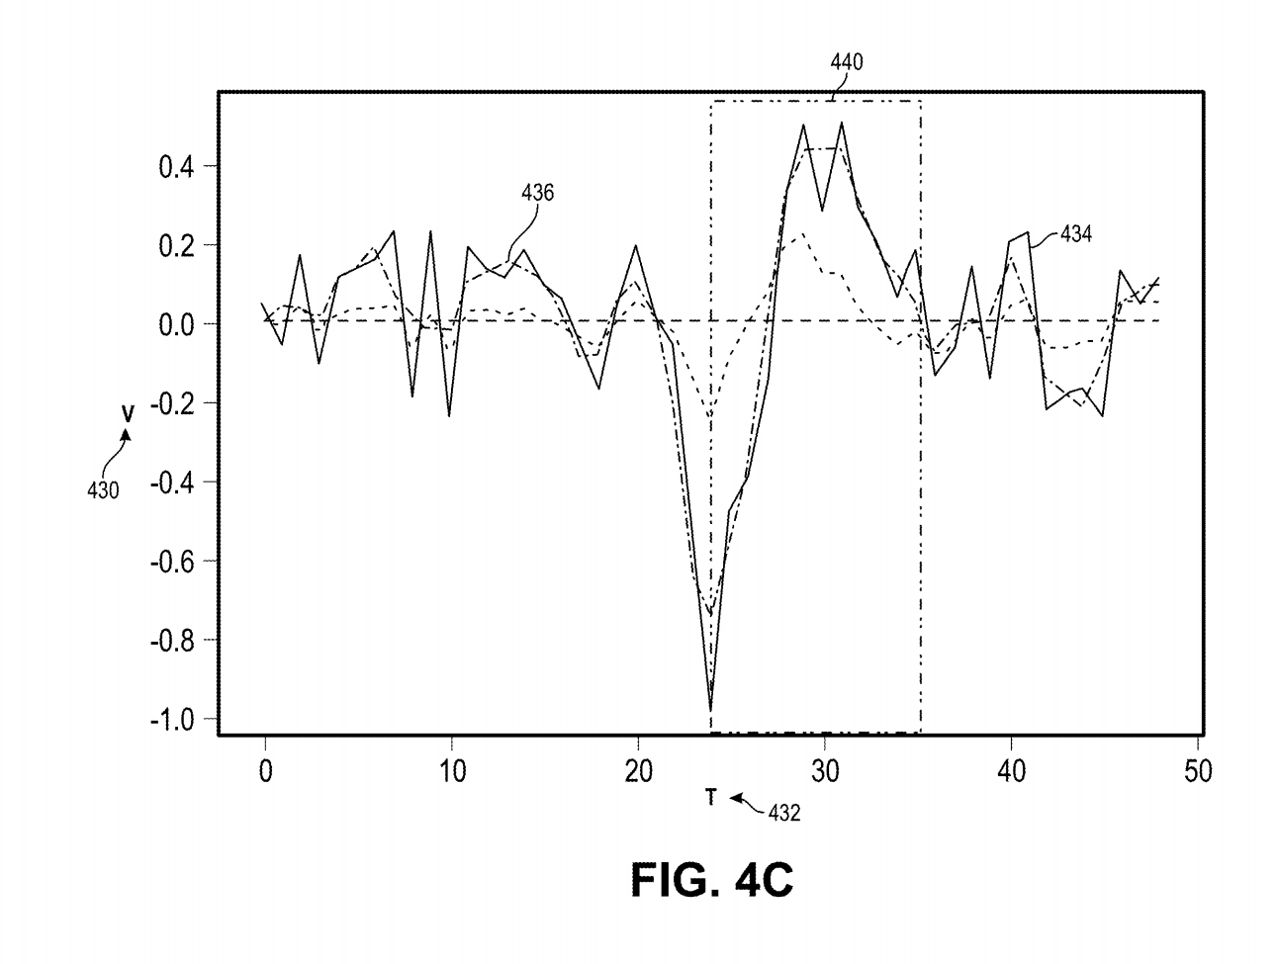
Identify local minima/maxima per time window
For each fixed time window (blackout period), want to find the local min and max
Notebook uses 40ms blackout period
Absolute deviation of the signal accumulated to smoothed function for fixed time period
Fixed configurable time period (blackout period)
smoothed
original

Slide 28
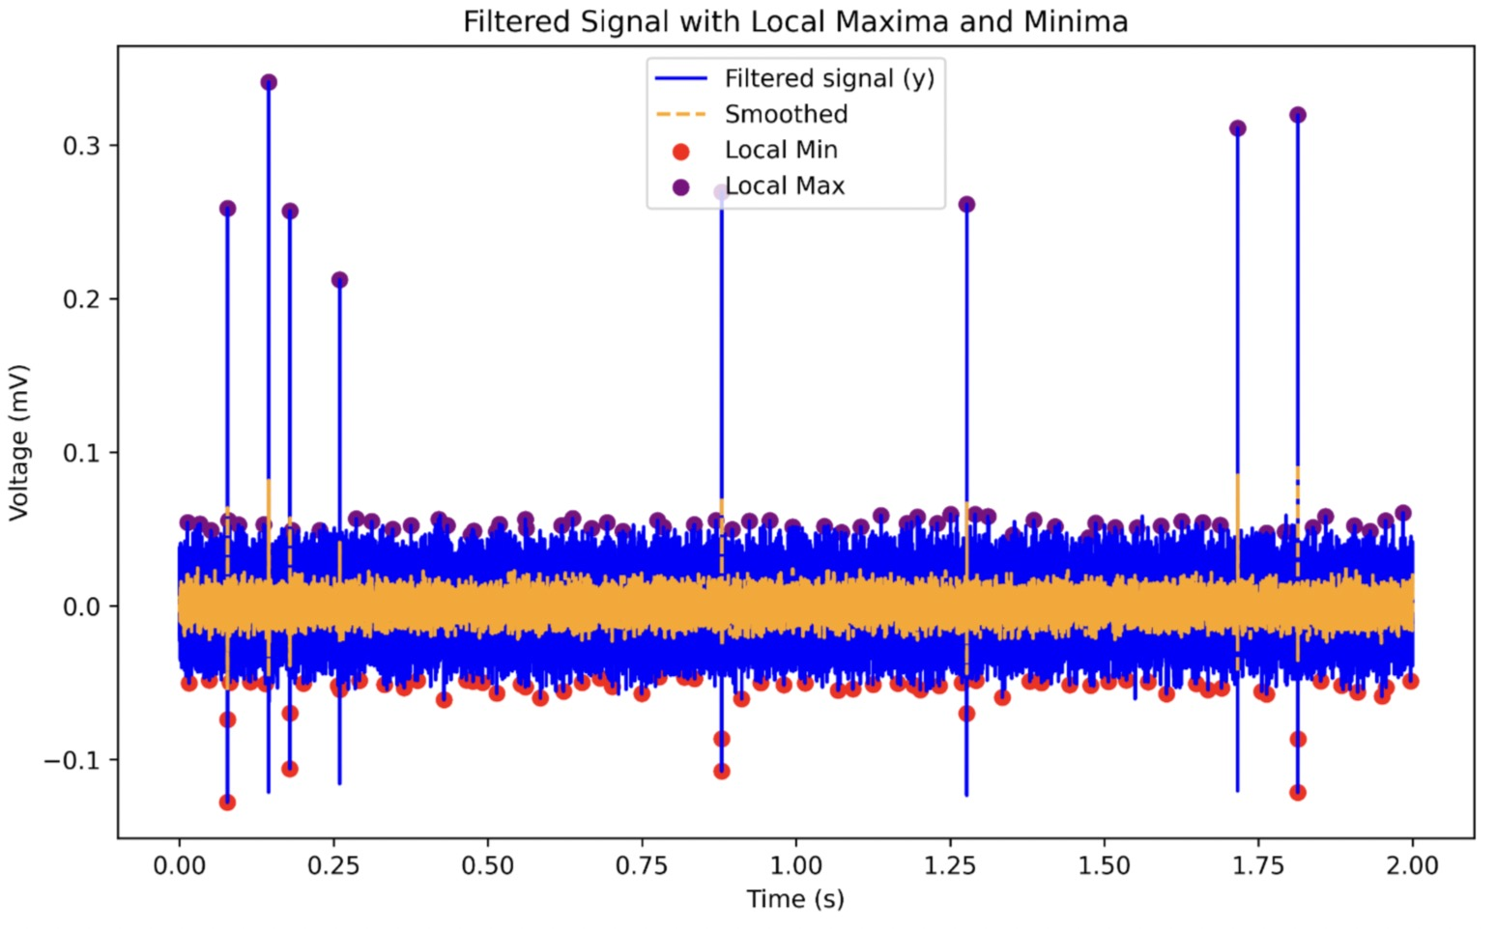

Slide 29
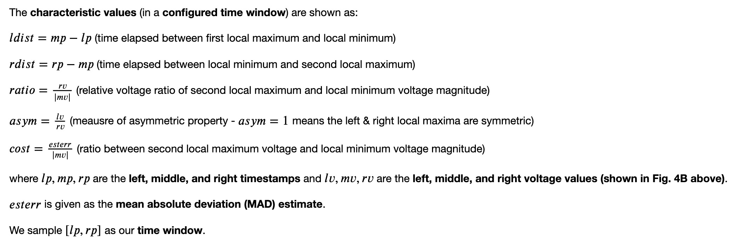
5. Compute Characteristic Values
In our notebook, we sample local max-local min-local max (lp, mp, rp) as our (non-fixed length) time window for characteristic value calculation. The local min and local max should be computed in the last step for each fixed-length time window.

Slide 30
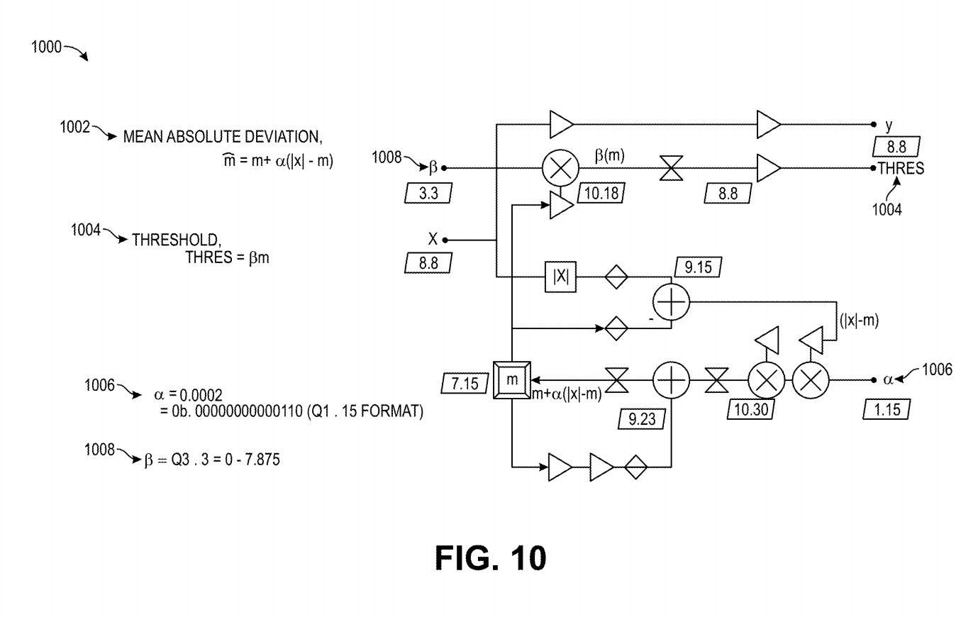
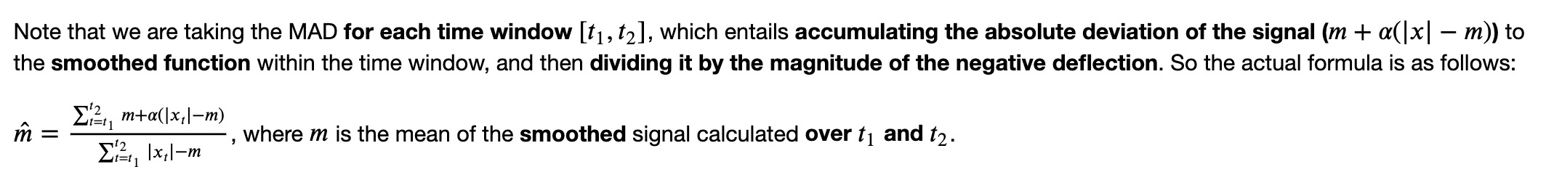
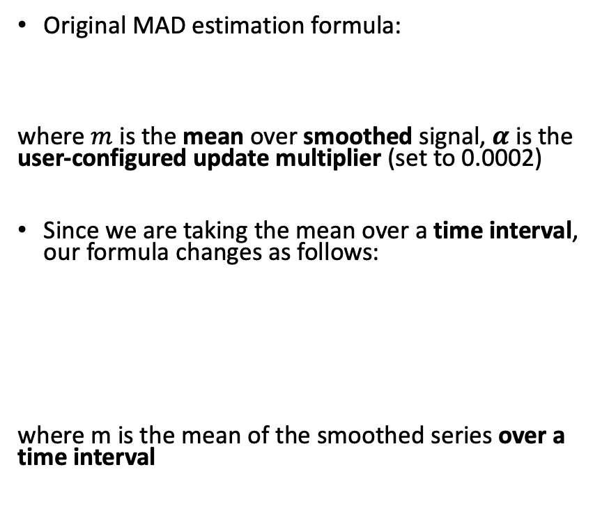
Mean Absolute Deviation (MAD)
Original MAD estimation formula:
where $m$ is the mean over smoothed signal, $α$ is the user-configured update multiplier (set to 0.0002)
Since we are taking the mean over a time interval, our formula changes as follows:
where m is the mean of the smoothed series over a time interval
Note: The patent uses a FIXED time window to compute the MAD + characteristic values, but we can just simply sample over the local min and max with NON-fixed windows. We can do this as long as our intervals are consistent.

Slide 31
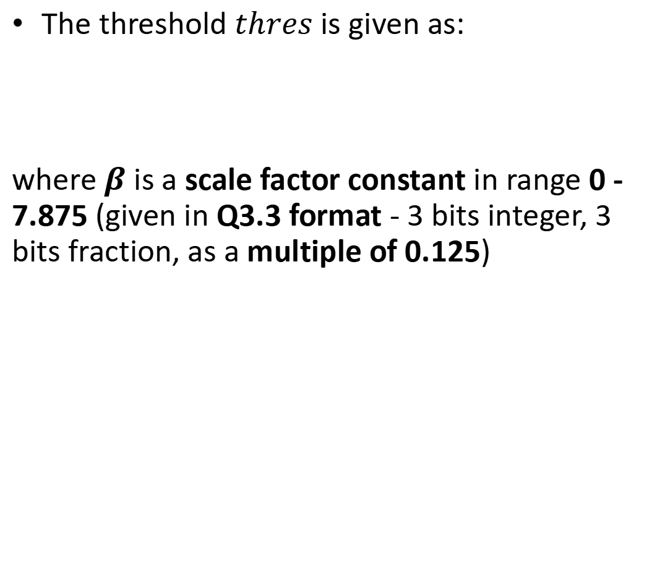
Threshold Calculation
The threshold $thres$ is given as:
where $β$ is a scale factor constant in range 0 - 7.875 (given in Q3.3 format - 3 bits integer, 3 bits fraction, as a multiple of 0.125)

Slide 32
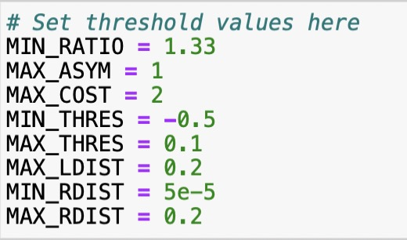
6. Determine Threshold Values
Can plot characteristic values separately to determine optimal threshold values
Plots can be shown in notebook
Final thresholds determined in figure on the right

Slide 33
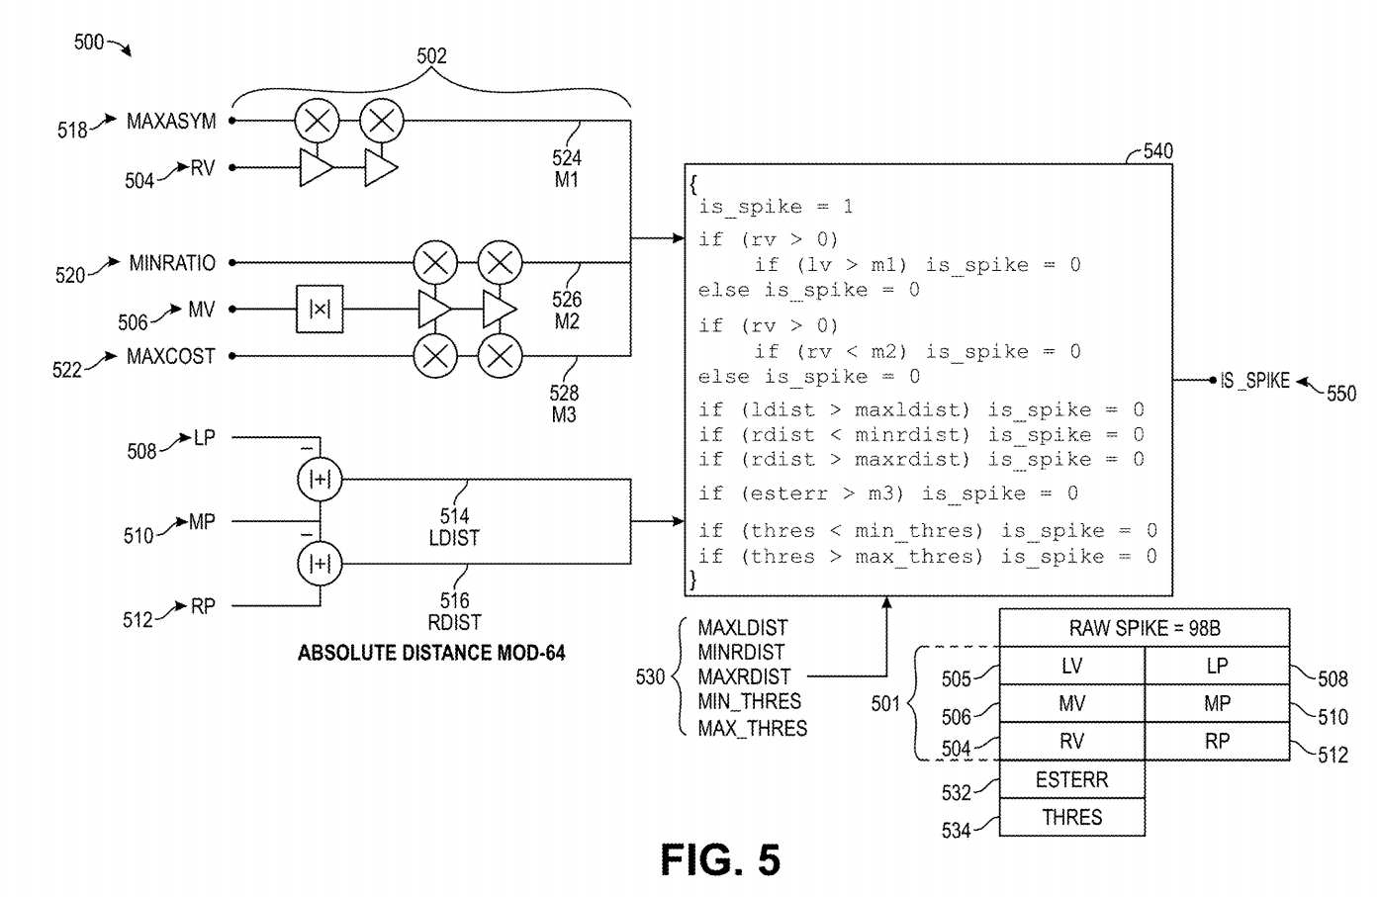
7. Determine whether spike is detected + timestamps of spikes

Slide 34
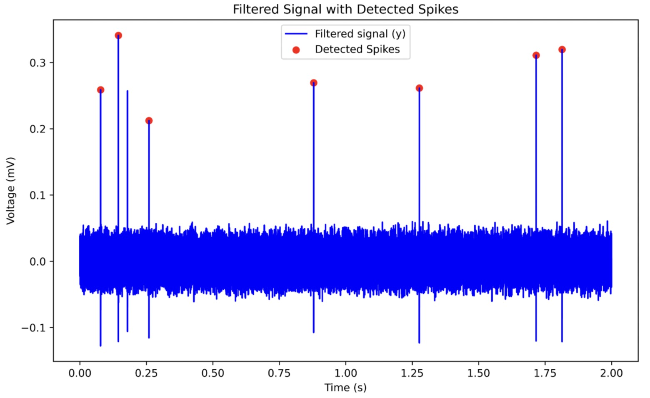

Slide 35
8. Transmit Indication of Spikes
Transmit ‘1’ + timestamp of when spike is detected (in binary or hex)
Can be transmitted via wired or wireless connection

Slide 36
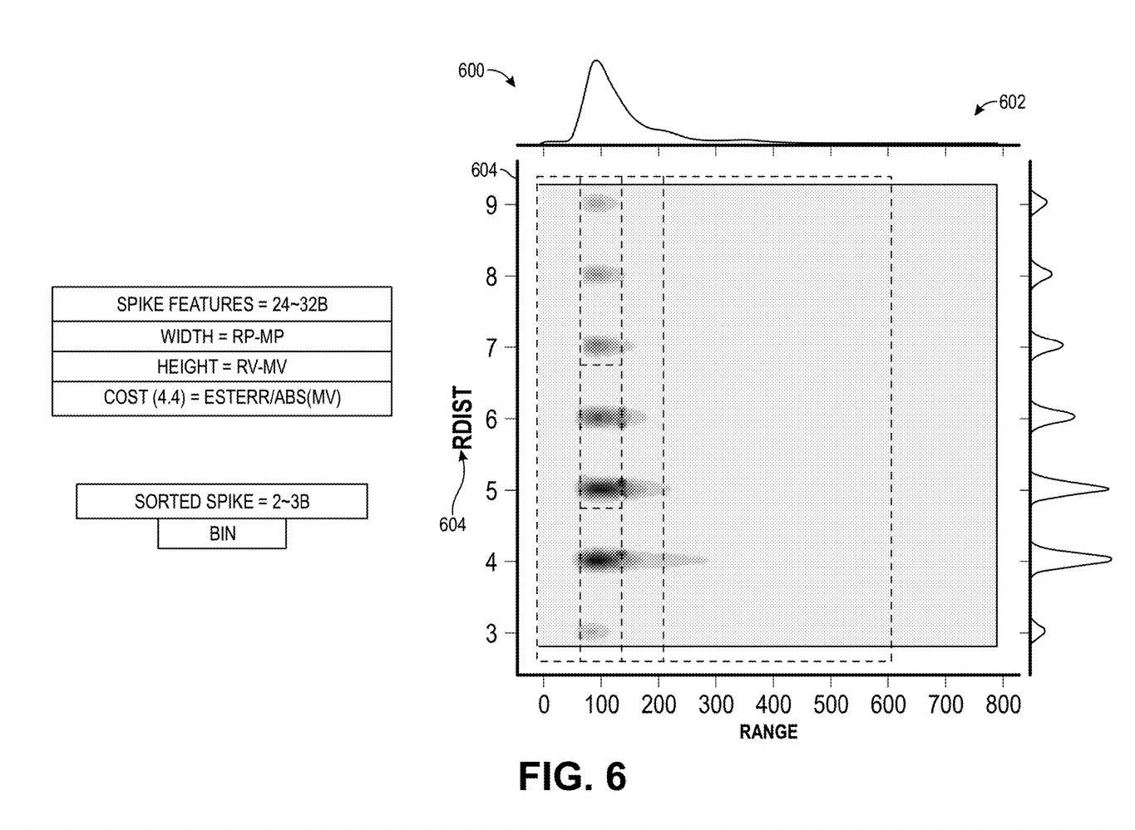
9. Characterizing spikes into bins (additional)
rdist: time between max and min voltage value
Can use ANY metric to classify (e.g., rdist, ldist, lv, rv, etc.)
Bins - Saves memory & time resources (compared to entire signal)
In practice: thousands/millions of neural signals + spikes!

Slide 37
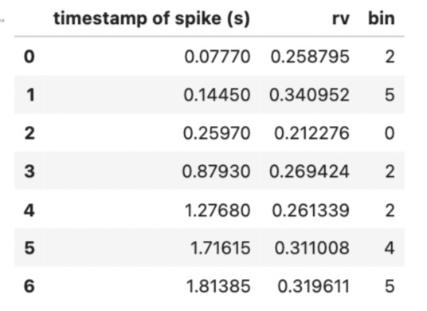

Example: Spike Characterization based on Right Voltage Value (rv)
Spikes divided into 6 bins based on lv (maximum voltage values)
Each bin has a specific range and assigned a value (0, 1, 2, 3, 4, 5)
More examples shown in notebook

Slide 38

Advantages of this system
Significant reduction in size of signal (while keeping useful information)
Reduce received waveforms by 3 orders of magnitude for low-power wireless transmission
1000 channels - Gb / s to Mb / s
Can be performed much faster with lower memory & storage requirements
Near real-time detection ($\sim 1μs$ from receiving signal to spike detection)
Less power consumption
1000 channels - consumes 1-2 mW per channel or less
256 channels - under 50mW (10x more reduction compared to prior systems)

Slide 39
Code Uploaded on Github
https://github.com/michaela10c/neuralink-patents/blob/main/Real-Time%20Neural%20Spike%20Detection/neural_spike_detection/Real-Time%20Neural%20Spike%20Detection.ipynb

